Slide 1
AZ-220T01 Module 02: Devices and Device Communication

Slide 2
Lesson 01: Learning objectives

Slide 3
Module 2 – Learning objectives
Explain the core features of the IoT Hub service
Describe the lifecycle of an Azure IoT device
Describe how IoT Hub manages device identities and implements other security features
Register devices with the IoT Hub using the Azure portal, Azure CLI, and Visual Studio Code
Implement the IoT Hub Device and Service SDKs

Slide 4
Lesson 02: IoT Hub Concepts

Slide 5
IoT Hub Capabilities
Capability | Basic tier | Free/Standard tier
Device-to-cloud telemetry | Yes | Yes
Per-device identity | Yes | Yes
Message routing, message enrichments, and Event Grid integration | Yes | Yes
HTTP, AMQP, and MQTT protocols | Yes | Yes
Device Provisioning Service | Yes | Yes
Monitoring and diagnostics | Yes | Yes
Cloud-to-device messaging |  | Yes
Device twins, Module twins, and Device management |  | Yes
Device streams (preview) |  | Yes
Azure IoT Edge |  | Yes
IoT Plug and Play Preview |  | Yes
IoT Hub capabilities are differentiated by Tiers
You can move from Basic to Standard on demand.
Notes:
Tell them you won’t be spending a lot of time on the feature details – the point of the table is to show that there is a difference. It is good to point out though that we will be using features in the course – like device twins – that are only in Free and Standard.
IoT Hub’s free tier is meant for testing and evaluation. The free tier does not support upgrading to Basic or Standard. It enables you to transmit up to a total of 8,000 messages per day and register up to 500 device identities. The device identity limit is only present for the Free Edition.
You may also want the pricing page to be handy: https://azure.microsoft.com/en-us/pricing/details/iot-hub/

Slide 6
IoT Hub Throughput
Tier edition | Sustained throughput | Sustained send rate
B1, S1 | Up to 1111 KB/minute per unit (1.5 GB/day/unit) | Average of 278 messages/minute per unit (400,000 messages/day per unit)
B2, S2 | Up to 16 MB/minute per unit (22.8 GB/day/unit) | Average of 4,167 messages/minute per unit (6 million messages/day per unit)
B3, S3 | Up to 814 MB/minute per unit (1144.4 GB/day/unit) | Average of 208,333 messages/minute per unit (300 million messages/day per unit)
IoT Hub throughput is differentiated by Editions
You can upgrade or downgrade editions at any time
Within an edition, you pay for a certain number of Units
Autoscaling possible through an Azure Functions implementation
Notes:
Tell them you won’t be spending a lot of time on the tier details, either – the point of the table is to show that there is a difference.
You may also want the pricing page to be handy: https://azure.microsoft.com/en-us/pricing/details/iot-hub/
Autoscaling is done through a Microsoft-provided sample that lives in Azure Functions: https://docs.microsoft.com/en-us/samples/azure-samples/iot-hub-dotnet-autoscale/iot-hub-dotnet-autoscale/

Slide 7
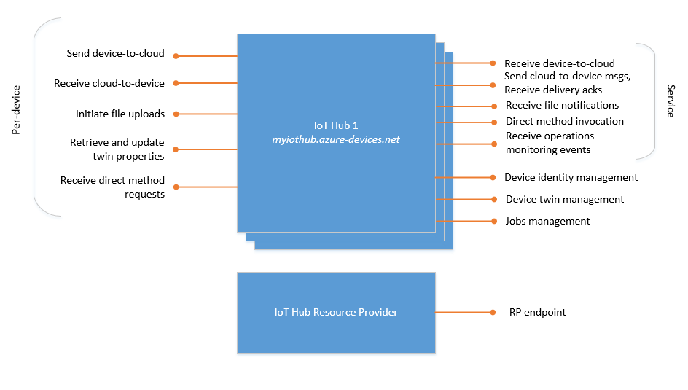
IoT Hub Endpoints
Built-in Endpoints
Custom Endpoints
Azure Storage containers
Event Hubs
Service Bus Queues
Service Bus Topics
Notes:
“IoT Hub has connectivity through endpoints to many different capabilities and services…”
Built-in Endpoints
Device endpoints (left)
Service endpoints (right, top)
Device identity management
Device twin management
Jobs management
Resource provider (right, bottom) - enables Azure subscription owners to create and delete IoT hubs, and to update IoT hub properties.
Custom endpoints
Azure Storage containers
Event Hubs
Service Bus Queues
Service Bus Topics
All endpoints use TLS and never expose unencrypted connectivity.

Slide 8

Introduction to IoT Hub Security Features
Access control and permissions
Hub-level shared-access policies (default and custom)
Device-level permissions
Authentication and security credentials
Security tokens (devices and services)
X.509 certificates (devices)
Notes:
We’ll be talking more about this in future slides – for now we’re introducing the terms for later reference, for the most part.

Slide 9
Lesson 03: IoT Device Lifecycle Concepts

Slide 10
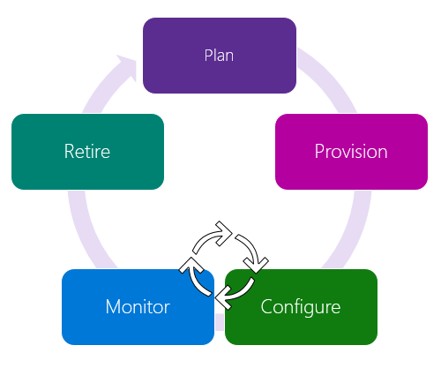
Device Lifecycle Terms and Concepts
Data Collection
(Telemetry)
Notes:
Plan: establish a device metadata scheme that supports device grouping for bulk operations
Provision: securely provision new devices to IoT Hub
Configure: facilitate bulk configuration and device management operations
Monitor: monitor overall device collection health and status
Retire: replace or decommission devices
During the Telemetry phase, the device is in the production “live” state.

Slide 11
Azure IoT Device Types
Plan
IoT Devices: Typically a small-scale, standalone computing device that may collect data or control other devices
IoT Edge Devices: IoT Edge devices have the IoT Edge runtime installed; can be used as a field gateway device
Note that while we often think of “IoT Devices” as hardware, there are also “simulated devices,” a software representation of a physical device that runs on your local machine or in the cloud.
Simulated devices can be used in various stages during the rollout of an IoT solution to represent individual device behaviors or to generate a telemetry workload.

Slide 12
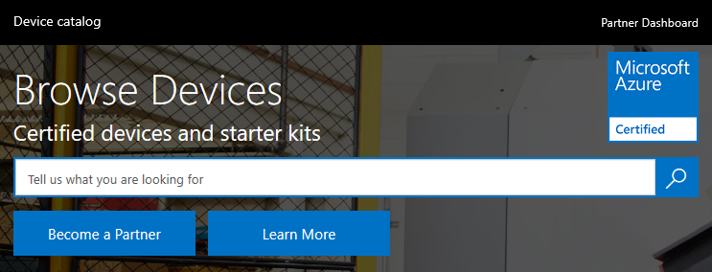
Microsoft Certified for IoT Device Catalog
Plan
Microsoft maintains an online device catalog that provides a list of hardware devices certified to work with IoT Hub at https://catalog.azureiotsolutions.com/alldevices.

Slide 13
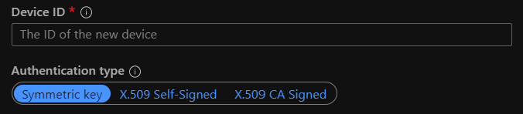
Azure IoT Device Registration
Provision
Creating a device registration in the IoT Hub identity registry requires, at a minimum:
A device id – the unique identifier you assign to a device
The authentication type – symmetric key or X.509 certificate
Both are used to authenticate the device to the IoT Hub, and both of these will be discussed in more detail later in the course.
Notes:
The official documentation on this is problematic and complicated with respect to identity as it confuses device identity, module identity, etc. while here we want device identity only.

Slide 14
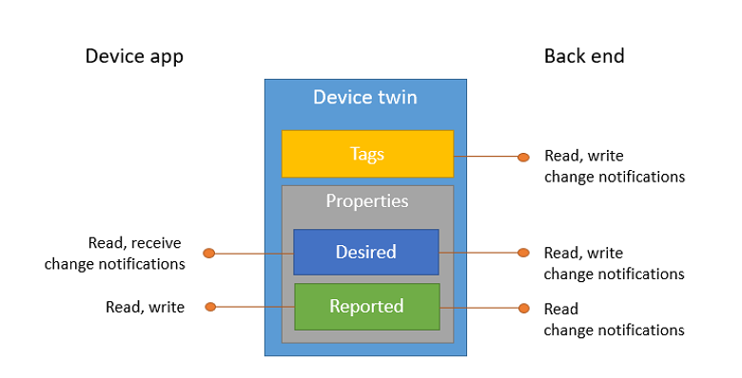
Introduction to Device Twins
Configure
Notes:
“Device configuration is generally done using a feature called device twins…”
Device twins are not available in the Basic tier. Don’t explain that now per se, although it may have already been mentioned in the earlier slide on the different levels of IoT Hub – just explain that Device Twins are the primary configuration mechanism, and be sure to introduce tags, desired properties, and reported properties, as well as briefly cover why you would use tags. Much later, we reference tags, assuming the student already knows what we mean.

Slide 15

Device Monitoring
Monitor
While the device is live, you need to monitor it…
Status – what’s happening with ongoing operations?
Health – is it working right?
Notes:
“Once a device is live, you need to monitor it during its lifecycle to ensure it’s working correctly…”
Again tell them that yes, we’ll do this more in detail later, we’re still in the overview here…

Slide 16

Device Retirement
Retire
At the end of a device’s lifecycle, it should be retired…
Disable – temporarily removes the ability of the device to communicate with the IoT Hub
Delete – removes the device registration completely
Notes:
“Once a device has reached the end of its useful life, it is appropriate to remove it from the system – this is referred to as ‘retirement’…”
Why might you disable instead of delete? If you think a device might be compromised and you’re investigating, for example, or if you have a provisioning workflow that requires you to perform configuration steps before the device can initially register.
deat

Slide 17
Lesson 04: IoT Hub Developer tools

Slide 18

IoT Developer Tools Overview
Software Development Kits (SDKs)
Visual Studio
Visual Studio Code
Command-Line Interfaces (CLIs)
Notes:
SDKs are covered more on the following slides

Slide 19
Azure IoT Hub SDKs
Benefits of using the SDKs
Develop a “future-proof” solution with minimal code
Leverage features designed for a complete software solution and focus on your specific need
Develop with your preferred language for different platforms
Benefit from the flexibility of open source with support from Microsoft and community
Included SDKs
IoT Hub Device SDKs
IoT Hub Service SDKs
Platform support
C, .NET (C#), Node.js, Java, and Python
Notes:
The SDKs are covered more on the next slides.

Slide 20

Azure IoT Hub Device SDKs: Languages
C (easily ported!)
C#
Java
Node.js
Python
Notes:
The C SDK has a porting guide (https://github.com/Azure/azure-c-shared-utility/blob/master/devdoc/porting_guide.md) to port it to other platforms.

Slide 21

Azure IoT Hub Device SDKs: Sample Platforms
Linux (Ubuntu, Debian, Raspbian)
Windows
MBED
Arduino
Huzzah, ThingDev, FeatherM0
FreeRTOS (ESP32, ESP8266)
.NET Variations
.NET Framework 4.5
PCL (Profile 7 – UWP, Xamarin.iOS, Xamarin.Android)
.NET Standard 1.3
Intel Edison
Notes:
This platform list comes from https://azure.microsoft.com/en-us/blog/benefits-of-using-the-azure-iot-sdks-in-your-azure-iot-solution/ and is not necessarily the current list.
This is not a comprehensive list of platforms, hence the title of the slide.
That blog lists the .NET MicroFramework – however, the SDKs have deprecated that support, so it’s not listed here.
The students will see a lot of SDK code in the labs so we’re not showing them on slides here except for a brief look later. Of course, as an instructor, you’re welcome to show some demo code if you wish – just be mindful of time.

Slide 22
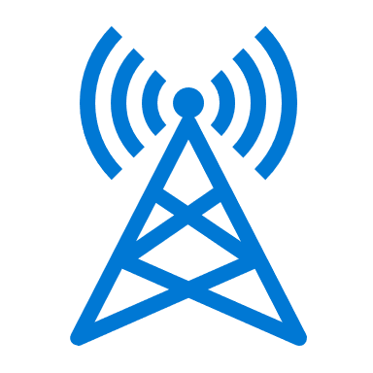
Azure IoT Hub Device SDKs: Protocols
MQTT
MQTT over WebSockets
AMQP
AMQP over WebSockets
HTTPS
Notes:
It’s a good time to mention that the WebSockets support means that on networks where 80 and 443 are allowed outgoing but other ports are not, there’s a solution available.
We’re going to return to the protocols in the next lesson, in the context of device communications rather than the SDK.

Slide 23

Azure IoT Hub Service SDKs
Coding language support
C
C#
Java
Node.js
Python
Backend Scenarios
Identity registry
Cloud-to-device messaging
Direct method operation
Querying
Jobs
File uploads
Notes:
On the backend scenarios, we’re going to cover a lot of these in detail more later.

Slide 24

Visual Studio Code Extensions
Azure IoT Tools collection
Azure loT Hub Toolkit
Azure loT Edge
Azure loT Device Workbench
Notes:
Azure loT Hub Toolkit
Azure loT Hub Toolkit extension provides everything that you need to start building IoT applications:
IoT Hub Management
Device Management
Module management
Interact with IoT Hub
Interact with Azure IoT Edge
Endpoints management
For more information on the Azure loT Hub Toolkit for Visual Studio Code, see: https://github.com/Microsoft/vscode-azure-iot-toolkit/wiki
Azure loT Edge
Azure IoT Edge extension makes it easy to code, build, deploy, and debug your IoT Edge solutions in Visual Studio Code, by providing a rich set of functionalities:
Create new IoT Edge solution
Add new IoT Edge module to Edge solution
Build and publish IoT Edge modules
Debug IoT Edge modules locally and remotely
IntelliSense and code snippets for the deployment manifest
Manage IoT Edge devices and modules in IoT Hub (with Azure IoT Toolkit)
Deploy IoT solutions to IoT Edge devices
For more information about the Azure IoT Edge for Visual Studio Code, see: https://github.com/Microsoft/vscode-azure-iot-edge/blob/master/README.md
Azure loT Device Workbench
The Azure IoT Device Workbench is a Visual Studio Code extension that provides an integrated environment to code, build, deploy, and debug your IoT device project with multiple Azure services supported. The extension also supports working with IoT Plug and Play by defining device capability model schemas and generating skeleton device code and projects.
For more information on the Azure IoT Device Workbench for Visual Studio Code, see: https://github.com/Microsoft/vscode-iot-workbench/blob/master/README.md

Slide 25
Azure CLI Tools
💻
Added by Azure CLI extensions for IoT
az extension add --name azure-iot
Hub Commands
create, delete, show-connection-string, etc.
Subgroup commands
device-identity, device-twin, etc.
Running CLI commands
Example
az iot hub create --resource-group MyResourceGroup --name MyIotHub
Getting help
az iot hub <command name> --help
az iot hub create –help
Notes:
You can easily demo these in Cloud Shell if you’d like once Cloud Shell is introduced (next slide)…

Slide 26
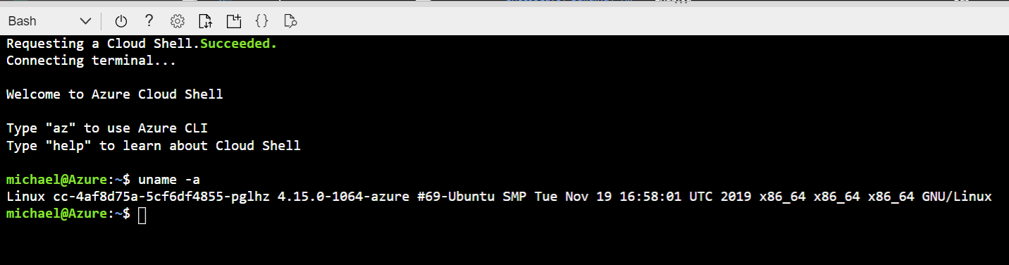
Azure Cloud Shell
A browser-based shell experience running Bash or PowerShell, with many common Microsoft and third-party tools installed
Notes:
You may want to spend a minute demoing Cloud Shell in a simple way – show that for example “az --version“ works, which means the CLI is installed without you having to do anything. You can do this in the Azure Portal or directly at shell.azure.com.

Slide 27
Lesson 05: Device Configuration and Communication

Slide 28
Device Communication
Device-to-Cloud
Cloud-to-Device
Notes:
Remember that cloud-to-device is only available in Free and Standard tiers, not the Basic tier.
Cloud-to-device messages aren’t looked at as closely as device-to-cloud through the course. They are handled by calls against the device SDK that ask for messages, and they can be sent from device SDK calls (for example, by management tools requesting device behavior).

Slide 29
Communication Protocols: Protocol Comparison
Protocol | Port | When you should use this protocol
MQTT | 8883 | Use on all devices that do not require to connect multiple devices (each with its own per-device credentials) over the same TLS connection.
MQTT over WebSockets | 443
AMQP | 5671 | Use on field and cloud gateways to take advantage of connection multiplexing across devices.
AMQP over Websockets | 443
HTTPS | 443 | Use for devices that cannot support other protocols.

Slide 30
Communications Protocols: Considerations
Cloud-to-device pattern – HTTPS 1.0/1.1 require server polling rather than server push, so cloud-to-device messages are not efficient
Field gateways – MQTT and HTTPS do not support sharing a single TLS connection
Low resource devices – MQTT and HTTPS are lighter-weight libraries compared to the AMQP libraries
Network traversal – as previously shown, there are specific ports that need to be open that might be an issue
Payload size – MQTT and AMQP are fundamentally binary protocols and thus the payloads are more compact than HTTPS payloads
Notes:
The exam expects a candidate to know how to choose an appropriate protocol; however, in real life, it’s often dictated by someone besides the IoT developer, such as a network engineer or a security engineer. The developer needs to be able to act as a trusted advisor though and be able to intelligently communicate with the decision makers on protocol selection.

Slide 31
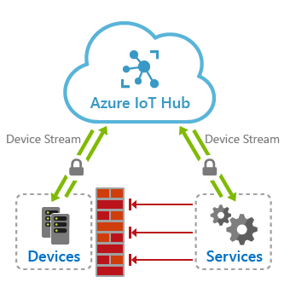
IoT Hub Device Streams (Preview) Overview
Benefits
Requirements
Notes:
Benefits
IoT Hub device streams provide the following benefits:
Firewall-friendly secure connectivity: IoT devices can be reached from service endpoints without opening of inbound firewall port at the device or network perimeters (only outbound connectivity to IoT Hub is needed over port 443).
Authentication: Both device and service sides of the tunnel need to authenticate with IoT Hub using their corresponding credentials.
Encryption: By default, IoT Hub device streams use TLS-enabled connections. This ensures that the traffic is always encrypted regardless of whether the application uses encryption or not.
Simplicity of connectivity: In many cases, the use of device streams eliminates the need for complex setup of Virtual Private Networks to enable connectivity to IoT devices.
Compatibility with TCP/IP stack: IoT Hub device streams can accommodate TCP/IP application traffic. This means that a wide range of proprietary as well as standards-based protocols can leverage this feature.
Ease of use in private network setups: Service can communicate with a device by referencing its device ID, rather than device's IP address. This is useful in situations where a device is located inside a private network and has a private IP address, or its IP address is assigned dynamically and is unknown to the service side.
Connectivity Requirements
Both the device and the service sides of a device stream must be capable of establishing TLS-enabled connections to IoT Hub and its streaming endpoint. This requires outbound connectivity over port 443 to these endpoints. The hostname associated with these endpoints can be found on the Overview tab of IoT Hub

Slide 32
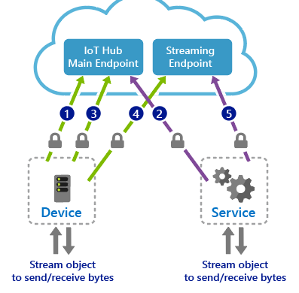
IoT Hub Device Streams (Preview) Workflows
Notes:
The device application registers a callback in advance to be notified of when a new device stream is initiated to the device. This step typically takes place when the device boots up and connects to IoT Hub.
The service-side program initiates a device stream when needed by providing the device ID (not the IP address).
IoT hub notifies the device-side program by invoking the callback registered in step 1. The device may accept or reject the stream initiation request. This logic can be specific to your application scenario. If the stream request is rejected by the device, IoT Hub informs the service accordingly; otherwise, the steps below follow.
The device creates a secure outbound TCP connection to the streaming endpoint over port 443 and upgrades the connection to a WebSocket. The URL of the streaming endpoint as well as the credentials to use to authenticate are both provided to the device by IoT Hub as part of the request sent in step 3.
The service is notified of the result of device accepting the stream and proceeds to create its own WebSocket client to the streaming endpoint. Similarly, it receives the streaming endpoint URL and authentication information from IoT Hub.
Device stream workflows
A device stream is initiated when the service requests to connect to a device by providing its device ID. This workflow particularly fits into a client/server communication model, including SSH and RDP, where a user intends to remotely connect to the SSH or RDP server running on the device using an SSH or RDP client program.
The device stream creation process involves a negotiation between the device, service, IoT hub's main and streaming endpoints. While IoT hub's main endpoint orchestrates the creation of a device stream, the streaming endpoint handles the traffic that flows between the service and device.

Slide 33
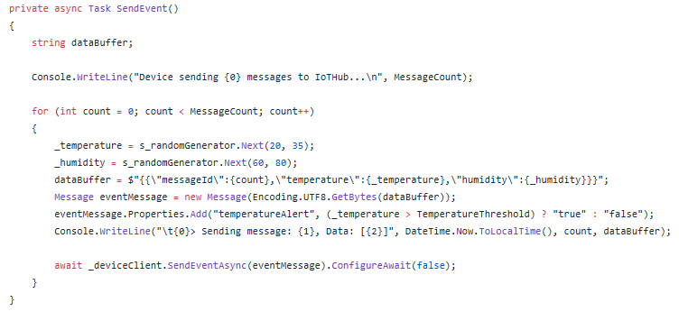
Device-Side Code Implementation Samples
Microsoft sample code projects
DeviceStreamingSample
FileUploadSample
ImportExportDevicesSample
KeysRolloverSample
MessageSample
MethodSample
TwinSample
XamarinSample
MessageSample C#
MessageSample.cs
MessageSample.csproj
Program.cs
Notes:
This slide is intended to illustrate that there are sample code projects out there.

Slide 34
Device-Side Code Implementation Code
Notes:
This slide is intended to give a quick look at what code might look like on the device side, in this case in C#. It’s not meant to be a detailed review, so don’t spend a lot of time on it – it’s just to give a feel of the code and what using the SDKs looks like.

Slide 35
Lesson 06: Module 2 Labs

Slide 36
Module 2 Labs
Lab 3: Setup the Development Environment
You will install the VS Code extensions for IoT
You will Install the Azure CLI extensions for IoT
You will verify that the dev environment is working properly
Lab 4: Connect IoT Device to Azure
You will create a new Device ID within Azure IoT Hub using the Azure CLI
You will configure a simulated device to connect to Azure IoT Hub
You will verify that device telemetry is being received by Azure IoT Hub

Slide 37
Lesson 7: Module 2 review questions

Slide 38
Module Review: Question 2.1
You have joined a team that is developing an IoT solution for your company. You will be implementing IoT Hub as part of your solution. The planning docs that you reviewed indicate that the solution will need to process a little over 5 million messages per day and will include both IoT Edge and regular IoT devices. The plans call for using the Basic tier, specify the B1 tier edition, and call for two units. When you think about it, this doesn’t seem to be correct.
What tier and edition of IoT hub will be needed and how many units? (choose one best answer)
B1 with 8 units.
B2 with 1 unit.
S1 with 8 units.
S2 with 1 unit.
Notes:
Correct Answer: D
Explanation: In the student workbook/skillpipe content, topic IoT Hub Tiers includes the following:
A table showing that the Basic tier does not support Azure IoT Edge, but the Standard tier does support Azure IoT Edge
A table showing that:
- B1/S1 support an average of 278 messages/minute per unit (400,000 messages/day per unit)
- B2/S2 support an average of 4,167 messages/minute per unit (6 million messages/day per unit)
Message throughput
Message traffic is measured for your IoT hub on a per-unit basis. When you create an IoT hub, you choose its tier and edition, and set the number of units available. You can purchase up to 200 units for the B1, B2, S1, or S2 edition, or up to 10 units for the B3 or S3 edition. After your IoT hub is created, you can change the number of units available within its edition, upgrade or downgrade between editions within its tier (B1 to B2), or upgrade from the basic to the standard tier (B1 to S1) without interrupting your existing operations.

Slide 39
Module Review: Question 2.2
You have joined a team that is developing an IoT solution for your company. You will be implementing IoT Hub as part of your solution. You are told that Device Twins will be used to help configure and manage devices throughout the device lifecycle.
Which of the following statements about Device Twins are true? (choose all correct answers)
Device twins are JSON documents maintained by IoT Hub.
Each device that is registered with IoT Hub has a Device Twin.
Device Twins include Tags, Cloud properties, Device properties, and Communication properties.
Device Twins include Tags, Desired properties, Reported properties, and Device identity properties.
Device Twins include Tags, Desired properties, Reported properties, and Lifecycle properties.
Notes:
Correct Answer: A, B, D
Explanation: In the student workbook/skillpipe content, topic Introduction to Device Twins includes the following:
Device twins are JSON documents that store device state information including metadata, configurations, and conditions. Azure IoT Hub maintains a device twin for each device that you connect to IoT Hub.
Device twins store device-related information that:
- Device and back ends can use to synchronize device conditions and configuration.
- The solution back end can use to query and target long-running operations.
The lifecycle of a device twin is linked to the corresponding device identity. Device twins are implicitly created and deleted when a device identity is created or deleted in IoT Hub.
A device twin is a JSON document that includes:
- Tags. A section of the JSON document that the solution back end can read from and write to. Tags are not visible to device apps.
- Desired properties. Used along with reported properties to synchronize device configuration or conditions. The solution back end can set desired properties, and the device app can read them. The device app can also receive notifications of changes in the desired properties.
- Reported properties. Used along with desired properties to synchronize device configuration or conditions. The device app can set reported properties, and the solution back end can read and query them.
- Device identity properties. The root of the device twin JSON document contains the read-only properties from the corresponding device identity stored in the identity registry.
Usage
Use device twins to:
- Store device-specific metadata in the cloud. For example, the deployment location of a vending machine.
- Report current state information such as available capabilities and conditions from your device app. For example, a device is connected to your IoT hub over cellular or Wi-Fi.
- Synchronize the state of long-running workflows between device app and back-end app. For example, when the solution back end specifies the new firmware version to install, and the device app reports the various stages of the update process.
- Query your device metadata, configuration, or state.

Slide 40
Module Review: Question 2.3
You have joined a team that is developing an IoT solution for your company. You are using the Azure Cloud Shell and Azure CLI commands to create some resources. You open the Cloud Shell and ensure that Bash is selected as the environment. You run the following two commands in the Azure Cloud Shell:
az group create --name MyAZ220RG --location westus
az iot hub create --resource-group MyAZ220RG --name MyIotHub
What will result when you run the commands? (choose all correct answers)
The first command will fail to create a resource group because no subscription is provided.
The first command will create a resource group named MyAZ220RG in the westus region.
The second command will fail because no pricing tier is specified.
The second command will fail because no region is specified.
The second command will create an IoT Hub using the F1 pricing tier in the region of the resource group.
Notes:
Correct Answer: B, E
Explanation: In the student workbook/skillpipe content, topic Azure CLI Support for IoT Hub includes the following:
Command az iot hub create : Create an Azure IoT hub.
Arguments --name –n [Required] : IoT Hub name.
--resource-group –g [Required] : Name of resource group.
You can configure the default group using `az configure -defaults group=<name>`.
--location –l Location of your IoT Hub. Default is the location of target resource group.
--sku Pricing tier for Azure IoT Hub. Default value is F1, which is free.
Note that only one free IoT hub instance is allowed in each subscription. Exception will be thrown if free instances exceed one.
Allowed values: B1, B2, B3, F1, S1, S2, S3.
Default: F1.
The command for creating an Azure Resource Group can be found in the lab setup scripts.
For example:
YourID="{YOUR-ID}"
RGName="AZ-220-RG"
IoTHubName="AZ-220-HUB-$YourID"
Location="{YOUR-LOCATION}"
# create resource group
az group create --name $RGName --location $Location

Slide 41
Module Review: Question 2.4
You have joined a team that is developing an IoT solution for your company. You are investigating how to implement 2-way communication between devices and IoT Hub.
Which of the following are valid options for sending information from devices to the cloud? (Choose all correct answers)
Device-to-cloud messages for scheduling firmware updates.
Device-to-cloud messages for time series telemetry and alerts.
Device twin's reported properties for reporting device state information.
Device twin's proposed properties for requesting device state information.
File uploads for media files and large telemetry batches.
Notes:
Correct Answer: B, C, E
Explanation: In the student workbook/skillpipe content, topic Device Communication includes the following:
Device-to-Cloud Communications
When sending information from the device app to the solution back end, IoT Hub exposes three options:
- Device-to-cloud messages for time series telemetry and alerts.
- Device twin's reported properties for reporting device state information such as available capabilities, conditions, or the state of long-running workflows. For example, configuration and software updates.
- File uploads for media files and large telemetry batches uploaded by intermittently connected devices or compressed to save bandwidth.

Slide 42
Module Review: Question 2.5
You have joined a team that is developing an IoT solution for your company. You are investigating how to implement 2-way communication between devices and IoT Hub.
Which of the following are valid protocol options? (choose all correct answers)
MQTT on port 8883.
MQTT over WebSockets on port 443.
AMQP on port 5671.
AMQP over WebSockets on port 443.
HTTPS on port 443.
Notes:
Correct Answer: A, B, C, D, E
Explanation: In the student workbook/skillpipe content, topic Communication Protocols includes the following:
Port numbers
Devices can communicate with IoT Hub in Azure using various protocols. Typically, the choice of protocol is driven by the specific requirements of the solution. The following table lists the outbound ports that must be open for a device to be able to use a specific protocol:
Protocol Port
MQTT 8883
MQTT over WebSockets 443
AMQP 5671
AMQP over WebSockets 443
HTTPS 443

